Slide 1
Water Quality Analysis

Slide 2
Overview
Abstract of the project
Dataset Analysis
Significance of fields in Dataset
Dataset Visualization
Modelling
Conclusion

Slide 3
Abstract of the project
Water is an essential commodity for all life forms on earth. In our project we are going to test ML models that will allow us to predict whether the water is safe to drink or not.

Slide 4
Dataset Analysis
The dataset contains 10 rows(ph, Hardness, Solids, Chloramines, Sulfate, Conductivity, Organic_carbon, Trihalomethanes, Turbidity, Potability) and 3277 columns
The dataset has missing values, so there is a need to use appropriate algorithms to fill in the missing values

Slide 5
Significance of fields in Dataset
ph : Indicator of acidic or alkaline condition of water, ranging from 1 to 14.
Acceptable Limit: 6.5 to 8.5
Hardness : Capacity of water to precipitate soap in mg/L.
Acceptable Limit: Upto 500 or 600 mg/L
Solids : Total dissolved solids (TDS) in ppm. The water with high TDS value indicates that water is highly mineralized.
Acceptable Limit: 500 - 1000 ppm
Chloramines : Amount of Chloramines in ppm.
Acceptable Limit: Upto 4 ppm
Sulfate : Amount of Sulfates dissolved in water in mg/L.

Slide 6
Acceptable Limit: Upto 400 mg/L
Conductivity : Electrical conductivity of water in μS/cm.
Acceptable Limit: Upto 400 μS/cm
Organic_carbon : Amount of carbon in organic compounds in ppm.
Acceptable Limit: Less than 2 mg/L
Trihalomethanes: Amount of Trihalomethanes in μg/L.
Acceptable Limit: Upto 80 ppm

Slide 7
Turbidity: Measure of light emitting property of water in NTU.
Acceptable Limit: 5-10 NTU
Potability: Indicates if water is safe for human consumption.
Here Potable -1 and Not potable -0.

Slide 8
Dataset Visualization
We can see that the values of non potable
Water is more than potable water, so
that means our dataset is not balanced

Slide 9
The dist plot values of ph shows as expected
Where it’s range is from 4 to 10 , and the
Potable range from 6 to 8.

Slide 12
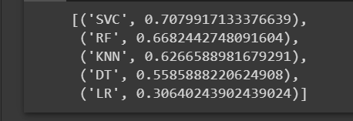
Modelling
We compared accuracy of different models and took the best models for analysis

Slide 13
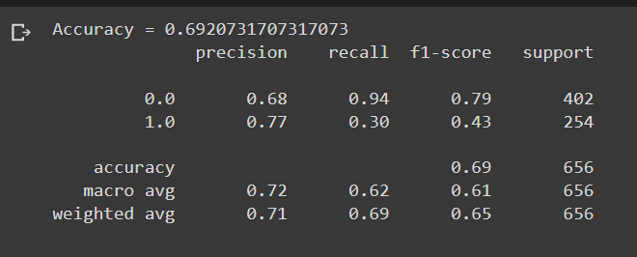
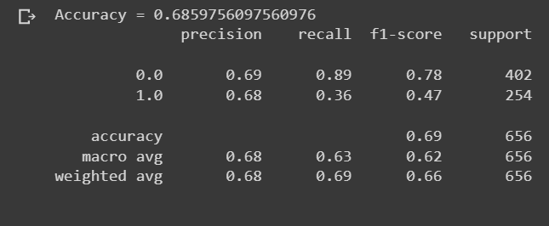
Support vector machine
Random forest

Slide 14
Conclusion
From our analysis we can conclude that the Support vector Classification Model gives the highest accuracy in predicting water quality ,i.e. Whether the water is potable or not (safe to drink)

Slide 15
Thank You
By:
Mallika - BL.EN.U4CSE19085
Vishnu Vijai - BL.EN.U4CSE19146 Sasidhar - BL.EN.U4CSE19153

